Slide 1

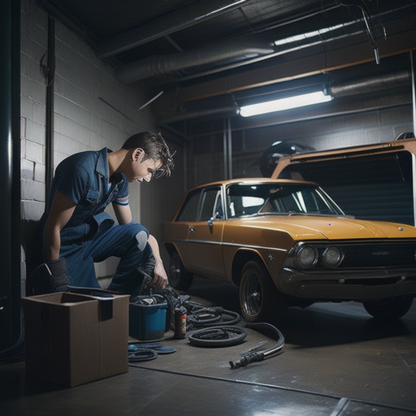
On-demand automobile service
Ghorer Garage
Group members
Abroor Zahin Niloy -2012464042
Akib Hasan-2011892042
Tania Akter Lima -2011566042
Naima Homaira khan-2012959042

Slide 2
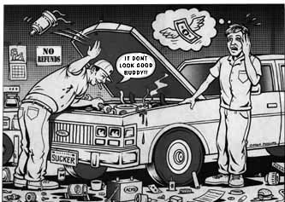
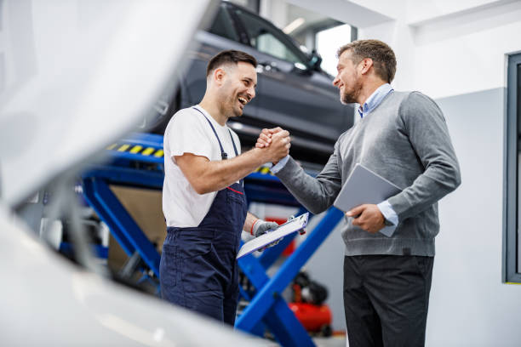
Ghorer Garage
General Description
When a person buy a new or used car, the first thing that comes to their mind is how they are going to maintain their car. Because most of the people in our country doesn’t have any proper knowledge about cars.
The problem about Bangladeshi car market is that the majority of the people prefers to buy reconditioned car rather than a brand new one from the authorized dealership due to high taxes and price.
Therefore most of the people doesn’t get any warranty support from the dealership and have to depend on the third party workshop. The problem with these workshop is that they are full of scammers. That’s what people are mostly worried about when they buy a new car.
Our target is to help those people to get rid of all those hassles.
With the help of our project these problems can be easily avoidable. With our project people from anywhere can book an appointment or they can choose the instant service option. There will be a text option where the clients can chat with our expert mechanics.
After getting a brief idea about the problem our expert mechanics will be at their door steps as soon as possible. So, the clients wouldn’t have to get the hassle of getting a trusted workshop, buying authentic parts within an affordable prices and so on.
The clients can choose home service or service on the go. The best part about us is that the customer will never have to worry about getting scammed. Because all the parts will be listed on our website with genuine serial numbers. With that the customers can easily verify the quality and actual price of each parts. Even they will be able to order instant fuel if they ever ran out of fuel in the middle of the road.
Our main motive is to give the people of our country a hassle free automobile experience that they never had before.

Slide 3

Ghorer Garage
Ghorer Garage
Target market
Bangladesh is a very overpopulated country and Dhaka is packed with traffic jam. Personally used cars are one of the main reasons behind Dhaka traffic. Compared to the users of car there aren’t many trusted workshop and there only a very few shops that provides online service and even they are not that convincing or not continuing it properly. So, there’s a huge opportunity here. If we can provide a hassle free automobile service there’s a huge potential market in here. Lots of people get stuck with their car in the middle of the road on a daily basis. They can contact through our app to us. No other company is providing this service in Bangladesh in a broad scale till now. So, we can say that, if we can utilize this project properly there’s a huge market for this in the Bangladeshi market.

Slide 4
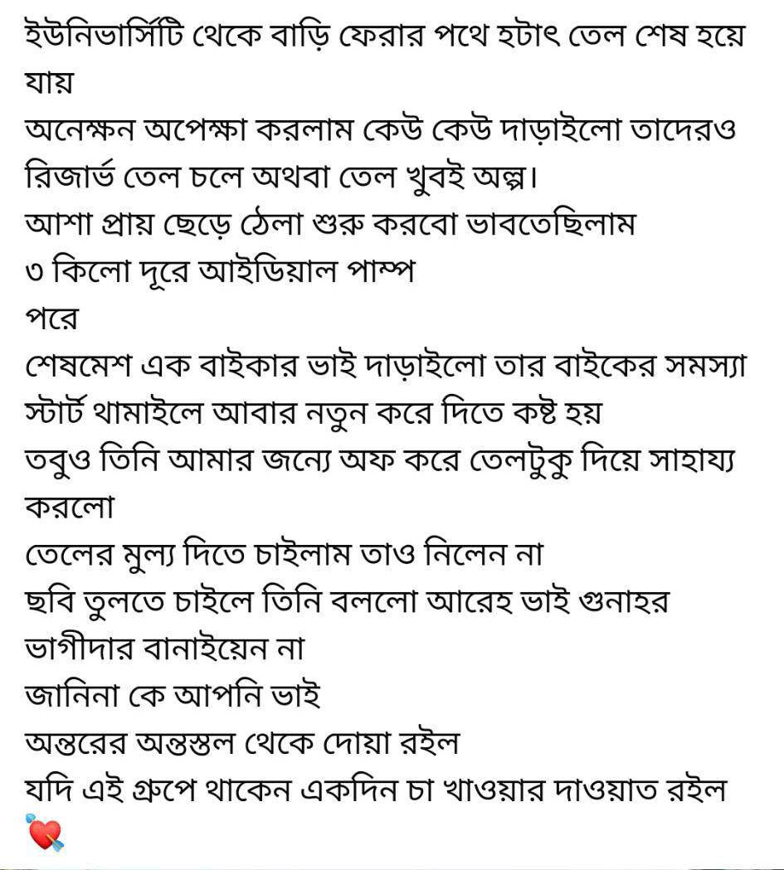
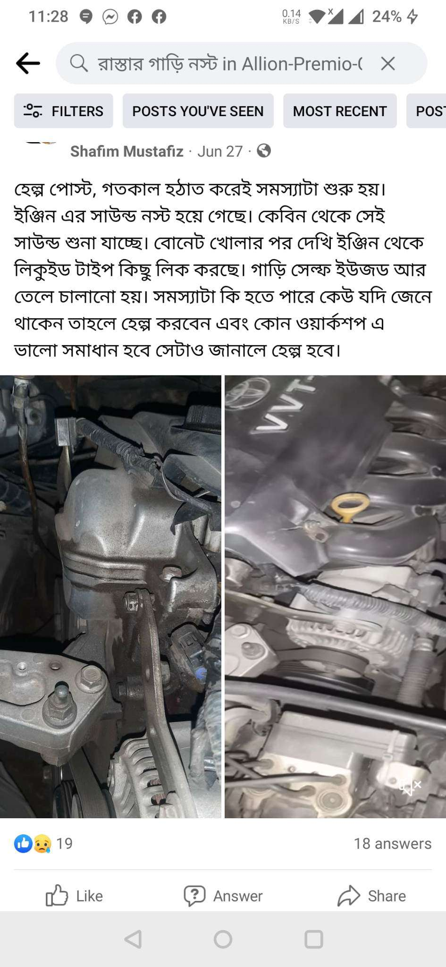
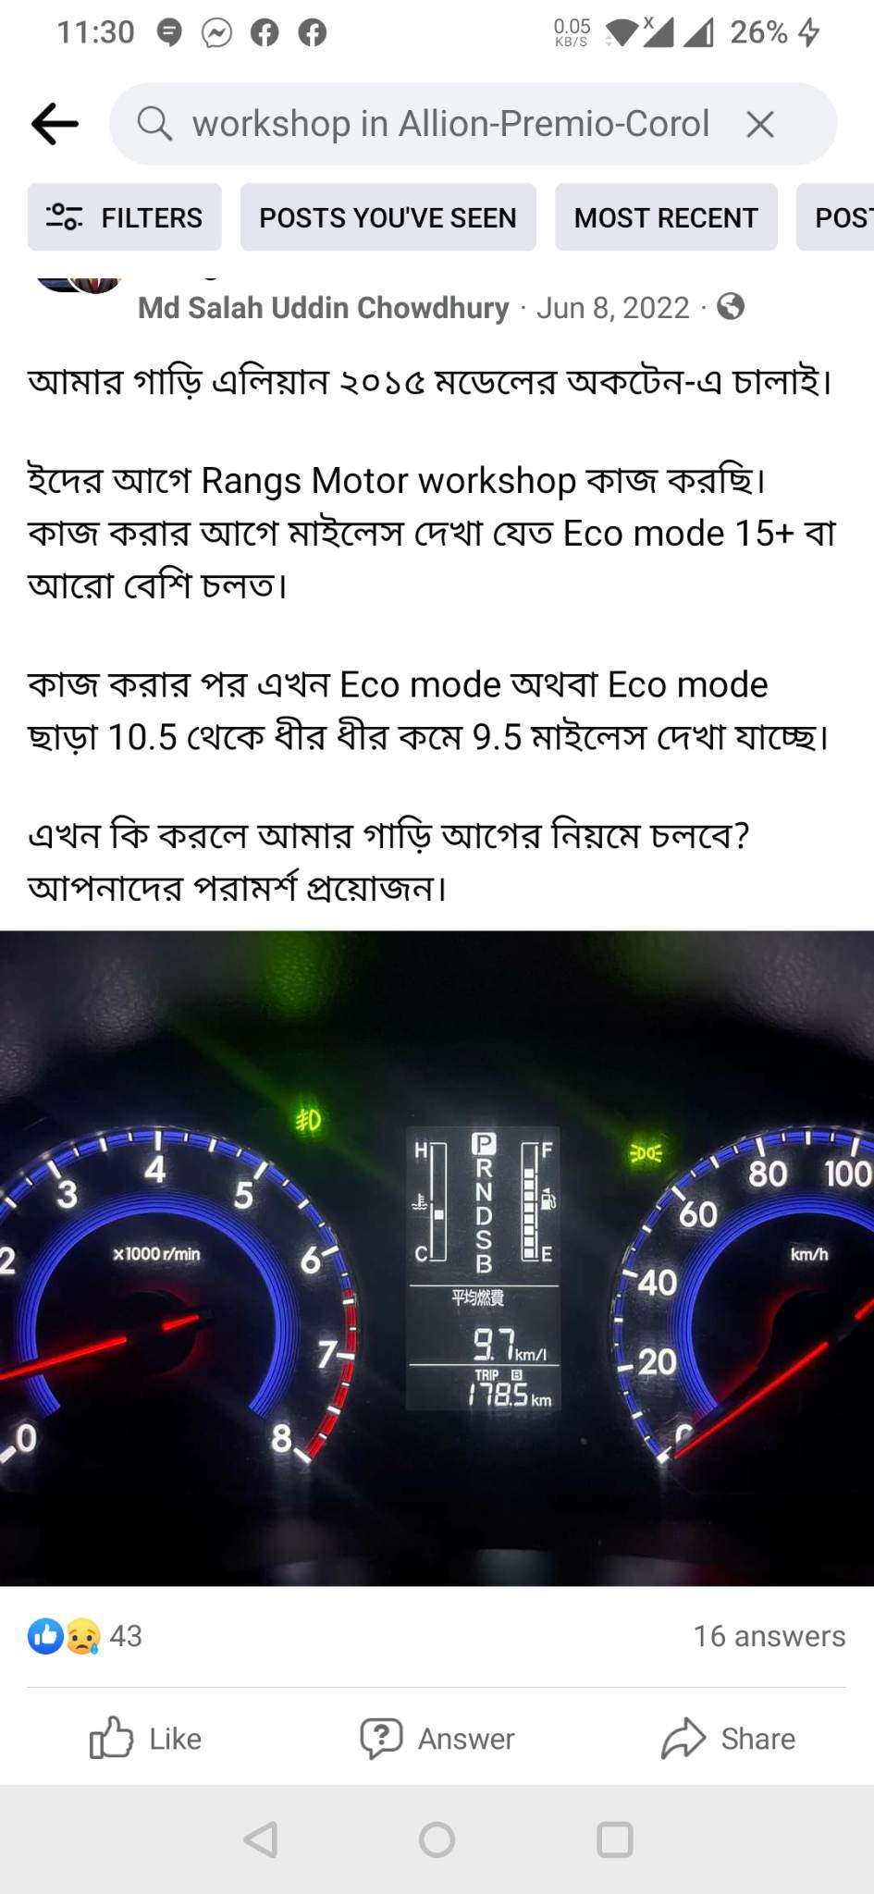
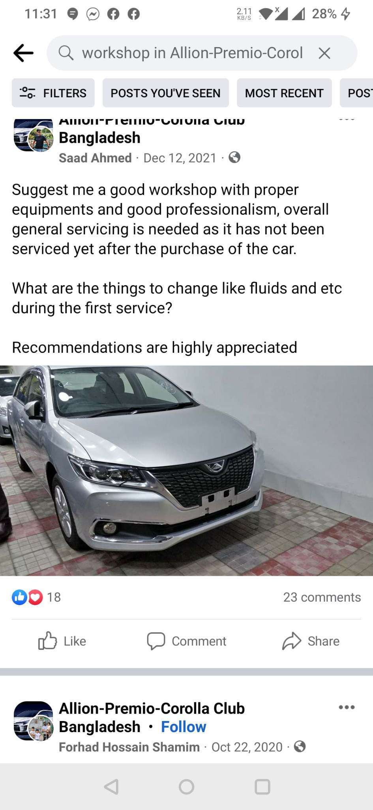
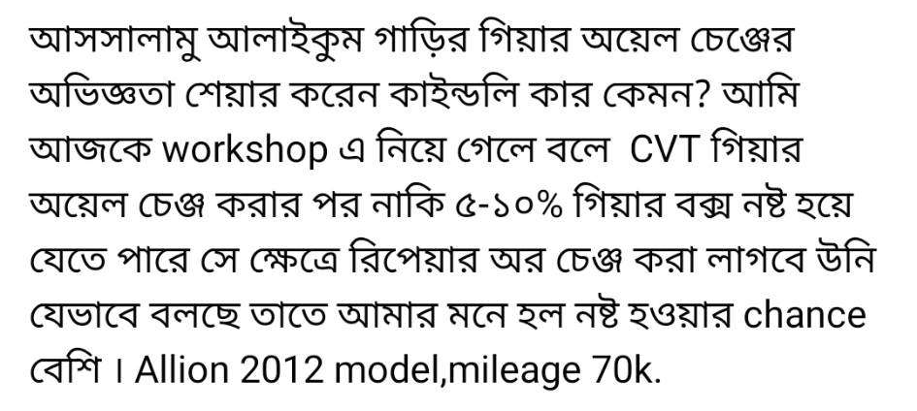
Ghorer Garage
research into the need,
problem or opportunity
We have done our research in both online and offline. If you keep a close eye on some of the car related Facebook group of our country you can have a very clear idea on how tensed people are about the maintenance of their car and they have a very little knowledge about these things. There are tons of well-known workshop who are proven to be scammer and that’s why people are scared to go to workshop. So, with our project this problem can be solved. We often see people running out of fuel or get stuck with technical difficulties with their vehicle in the middle of the road. This also can be solved with our project and there’s a huge opportunity for us to grow in this sector.

Slide 5
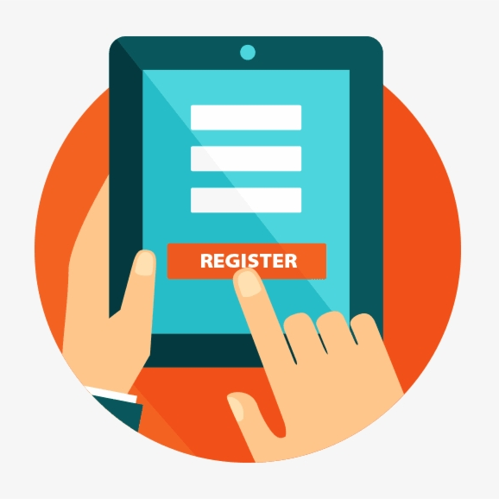
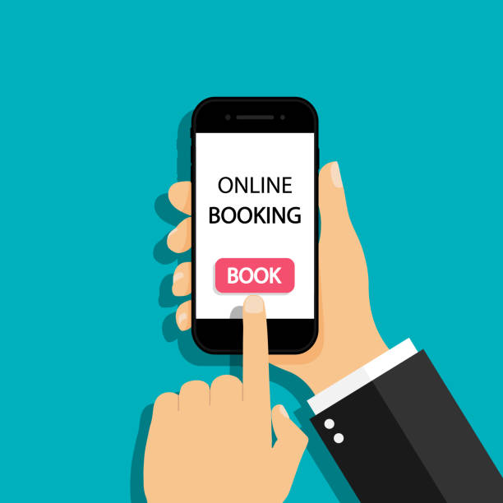
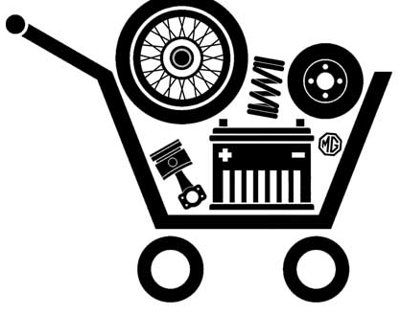


Ghorer Garage
Ghorer Garage
Features
Registration
Booking System
Listing of Parts and services
Online/Offline Payment method
By registering our service, users will get a unique username and account. By this account, users can track their orders, bills etc.
With our service clients can book an appointment via mail or chatting option. Within 10 minutes prior booking our representative will contact them. For instant service the customers can call to the help line for instant response.
There will be a list of car parts for different models of car. Their prices will be also mentioned along with their serial number for the authenticity of those parts. The services will also be listed. From there customers can easily pick their needed service and our expert mechanics can suggest them the right parts.
Our customers will have variety of payment options. They can use various kinds of banking cards or they can even use mobile banking. They can also choose cash on delivery.

